Slide 1
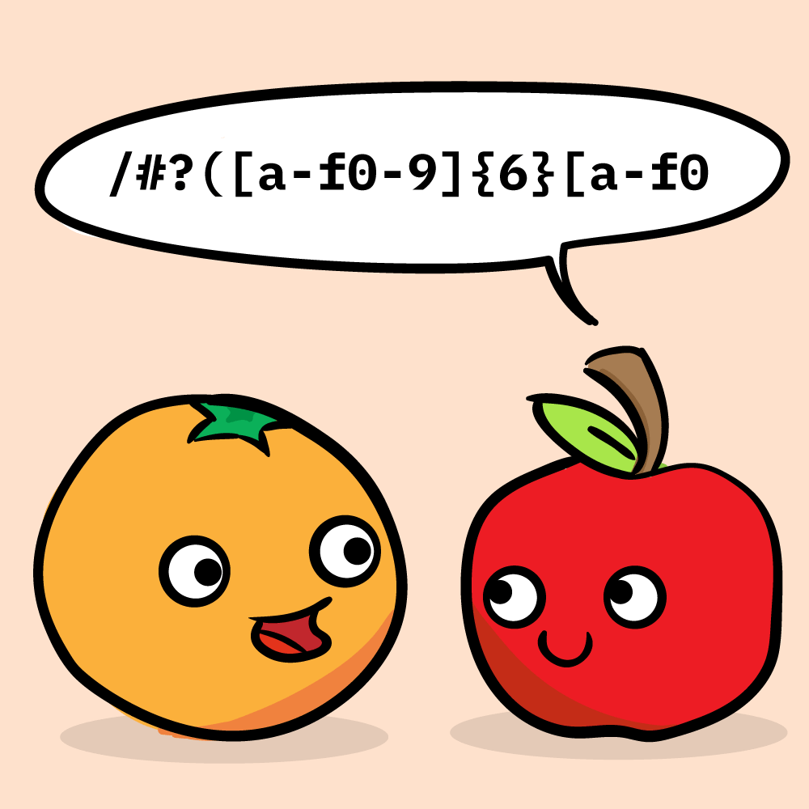
Regular Expressions
Presented By :- Snehal Tawar

Slide 2
Regular Language:
Regular Expression is a method to represent Regular languages.
Regular languages are those that are accepted by Finite Automata.
A language is said to be regular if there exists a regular grammar to generate it.

Slide 3
Rules:
Any terminal symbol i.e. symbols epsilon,sigma including ^ and phi are reguar expressions.
Union of two regular expression is also a regular expression. (R₁+R₂)
Concatenation of two regex is also a regex. (R₁.R₂)
Iteration or closure of regex is also a regex. R -> R*
a* = ^,a,aa,aaa, …
5. Regular expressions over sigma are precisely those obtained recursively by the application of the above rules once or several times.

Slide 4
Examples:
It’s a closure when all the strings can be formed by symbol along with ‘^’ (empty) symbol.
Closure of symbol represented by cross ‘+’ when ‘^’ is not present.
1. {0,1,2}
R = 0+1+2
2. {^,ab}
R = ^ ab
3. {abb,a,b,bba}
R = abb+a+b+bba
4. {^,0,00,000,….}
R = 0*
5. {1,11,111,1111,….}
R = 1⁺

Slide 5
Regular Expression:
1. Regex is said to be valid if it can be derived from the primitive Regex by a finite number of application of the rule.
r*,r⁺ ,r₁.r₂ ,r₁+r₂
2. If sigma is a given alphabet then, phi,epsilon/lambda are primitive regex.

Slide 6
THANK YOU !

